Slide 1
Academic Review A dive into the effects of different variables on student performance in US Public Schools
Paper Straws. LLC
Notes:
mw

Slide 2

Motivation
NFL → Radiation → Books → Plastic Waste → Education
Background: The team decided on Education due to the numerous and robust datasets available, and less so due to personal interest in the topic.
Reasoning:
Discoursed topic
Relatable topic
Digestible topic
Enrollment in GT bootcamp
David’s kids
Notes:
mw

Slide 3
Core Questions and Hypotheses
Is student performance* in the US affected by student:teacher ratio?
Is student performance* in the US affected by teacher salary?
Is student performance* in the US affected by school financials?
Is student performance* in the US affected by per student spending?
Null hypotheses (Ho): Student:teacher ratio does not have an effect on student performance
Null hypotheses (Ho): Teacher salary does not have an effect on student performance
Null hypotheses (Ho): School financials do not have an effect on student performance
Null hypotheses (Ho): Per student spending does not have an effect on student performance
*”Student performance” defined as High School graduation rate
Notes:
scott

Slide 4

Discovery and Analysis
Notes:
scott

Slide 5

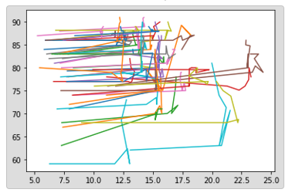

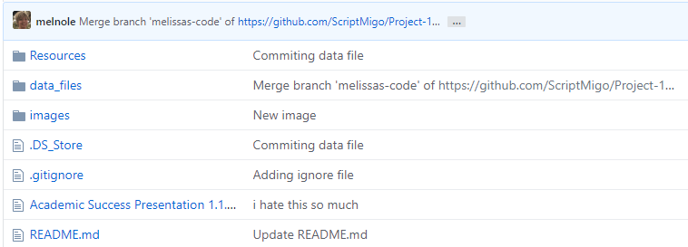

Our Process
Notes:
Sean

Slide 6

Discovery and Data Sources
Google
Kaggle
US Department of Education
US Department of Labor
National Center for Education Statistics (NCES)
National Education Association (NEA)
Census
Our Brains!
Notes:
Sean

Slide 7
Data Cleanup
Get pic of team hanging out with coffee, in a bar ,whatever
Deep dive into datafiles
Re-defined parameters
Re-established metrics
Pic of saurin working on laptop v concentrated
Notes:
Saurin

Slide 8
Data Analysis
Review datasets
Discuss strategy
Brainstorm visualizations
Manipulate data real-time
Determine charts and chart types for presentation
Identify data for statistical analysis requirement
Analyze data and visualizations, uncover findings
Notes:
Saurin

Slide 9
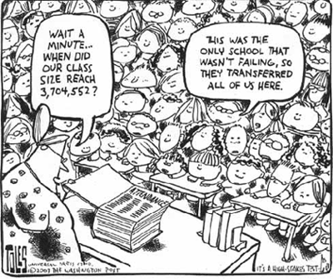
Findings
Notes:
Saurin

Slide 10
US Public Schools Overview
About 57m students attended elementary, middle, and high schools across the US in 2019
Highest enrollment ever reported for public schools
3.7m teachers 2019
Average salary $59k
US gov’t allocates 8% to public schools ($706B)
Best graduation rate:
Missouri 88%
Worst graduation rate:
DC 69%
Notes:
mw

Slide 11
Key Findings
Notes:
scott

Slide 12
Aggregate Findings – US Trends
Saurin: * student:teacher ratio us
do not have : teacher salary us
*school financials us (total rev, total expend)
*those charts you have re deficit if want/need
*Per student spending us
*Grad rate
Notes:
Saurin

Slide 13
Granular Findings - State Regress
Sean: grad rates v student teacher ratio us
grad rates v teacher salary us
grad rates v school financials us (one total rev one total expend)
saurin: grad rates v per student spending linregress also
Notes:
sean

Slide 14
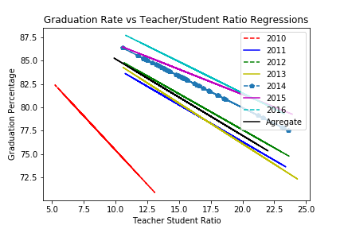
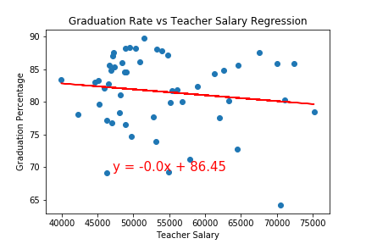
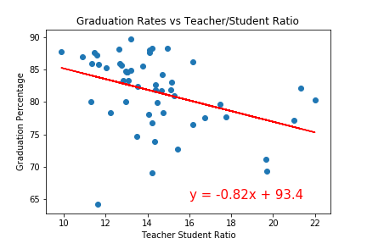
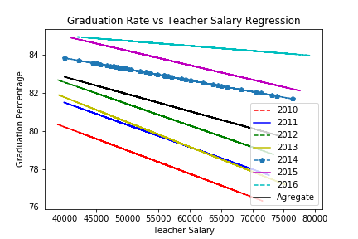
Granular Findings - State Regress
Notes:
sean

Slide 15
Granular Findings - State Regress
Notes:
sean

Slide 16
Micro Findings – Georgia Regress
This is the first class not required to take the Georgia High School Graduation Test in order to receive a regular diploma, as Georgia moves away from a one-size-fits-all approach to graduation.
There is evidence that focusing less on testing, and more on career education and personalized paths to graduation, opens up opportunities for students. The graduation rate for students who complete a Career Pathway is much higher – at 89 percent – than the rate for students who do not.
Moving forward, the GaDOE will continue to focus on personalized learning rather than a standardized approach – including Career, Technical and Agricultural Education (CTAE) and core credit flexibility, including the new flexibility that allows students to receive a math, science, or foreign language credit for a computer programming course.
The agency is also working to improve the graduation rate for students with disabilities through a statewide systemic improvement plan which establishes a network of regional support to support local districts in implementing interventions provided by the National Dropout Prevention Center.
Notes:
mw

Slide 17
Micro Findings – Georgia
melissa:
grad rates v student teacher ratio ga
grad rates v teacher salary by state ga
grad rates v school financials by state ga total rev, total expenditure
grad rates v per student spending by state ga
Notes:
mw

Slide 18
Regional Findings – Statistical Testing
Scott: ANOVA ga vs SE w t test
.describe on GA
Notes:
scott

Slide 19

Implications
Notes:
scott

Slide 20
Implications
Discuss the implications of your findings. This is where you get to have an open-ended discussion about what your findings "mean".
Notes:
Sean/saurin

Slide 21
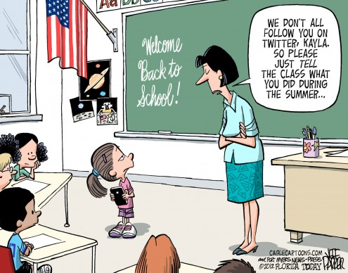
Appendix
Notes:
mw

Slide 22
Saurin financial pie charts here
Saurin deficit chart and other one that goes with it

